Slide 1

Collaborative Dental Hygiene Practice in Community Settings:
Past, present and future
Clare Larkin RDH MSEd
April 2022
Notes:
Hello everyone,
My name is Clare Larkin, I’ve been licensed as a dental hygienist since 1977.
I’m honored to be with you today to talk about an innovative workforce model called “collaborative dental hygiene practice in community settings”
I will share a bit of the past, i.e. the “history”, talk about the present and introduce some ideas that advocates hope will happen in the near future
Before we get started, I want to point out that this presentation refers to “dental hygiene” collaborative practice/agreements; not collaborative agreements for licensed dental assistants or collaborative management agreements for dental therapists

Slide 2
Objectives
After attending this program, the participant should be able to:
Define the phrase “Collaborative Dental Hygiene Practice in Community Settings.”
Recognize the value of Minnesota’s 21st Century Dental Team Toolkit/website to establishment of a collaborative dental hygiene practice program.
Describe what is meant by a [community] health care setting.
Describe the steps involved with creating a written collaborative agreement; registration with Board of Dentistry.
Describe the steps involved in community-based oral health care delivery.

Slide 3
Collaborative Dental Hygiene Practice (CDHP):
What it is…
a dynamic process; a commitment to interact on a professional level; participants blend their talents to achieve a goal that neither can do alone
a mechanism to serve the community
requires a formal written document that outlines the practice relationship between the dental hygienist and dentist
authorizes services that may be performed by the dental hygienist without the presence of a dentist; without a prior exam of the patient by a dentist
Notes:
Interaction on a professional level
Blend talents
Mechanism to serve the community
Formal written document outlining parameters of the agreement
Although the presence of a dentist is not required, nor is a prior exam of the patient by a dentist….
THIS DOES NOT IMPLY INDEPENDENT DENTAL HYGIENE PRACTICE

Slide 4



Collaborative Dental Hygiene Practice (CDHP):
What it isn’t…
Collaborative agreements were introduced for community-based, not traditional, dental hygiene practice.
Collaborative agreements written for community-based practice should be registered with the Minnesota Board of Dentistry.
In a traditional dental practice, it is not appropriate, nor necessary, to develop a collaborative agreement with staff to provide services, e.g., expose radiographs or “see a new patient first.”
Notes:
Community-based, not traditional, dental hygiene practice
If these collaborative agreements are registered with the Board of Dentistry, the ability to show the impact made through this innovative workforce model becomes skewed.

Slide 5
“Collective Impact”
Public health and oral health
professionals, educators, lawmakers,
stakeholders, community members, others
Notes:
Carried out with a mindset of “collective impact” and “service to your community”.

Slide 6
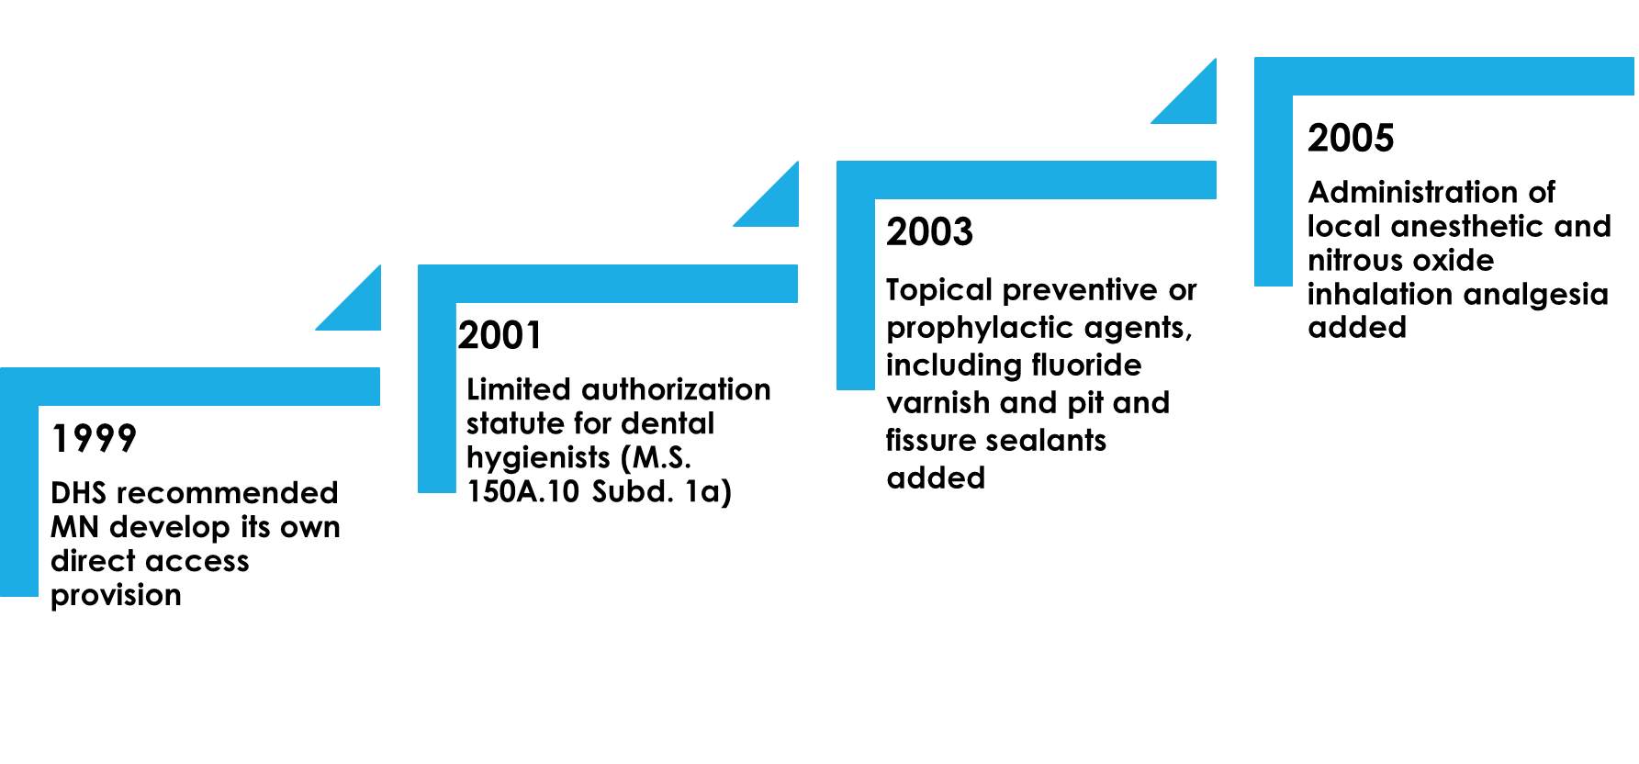
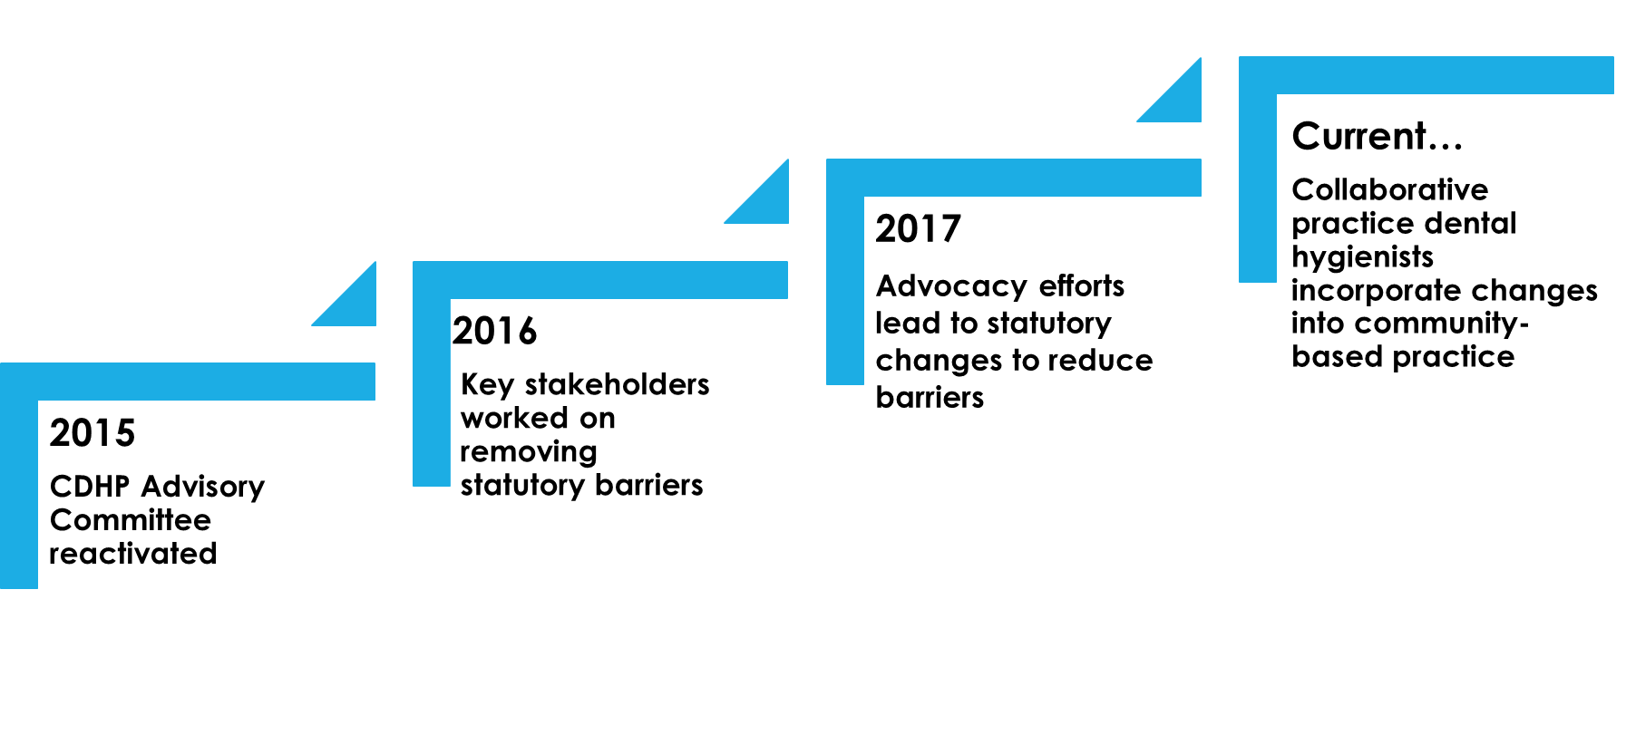
Historical Perspective
Minnesota Chapter 150A.10 Subd. 1a
Notes:
M.S. 150A.10, subd. 1a is NOT new !!!
However, we are frequently asked “why haven’t I learned about this”?
Let start today by recognizing how much sense this practice model makes.

Slide 7
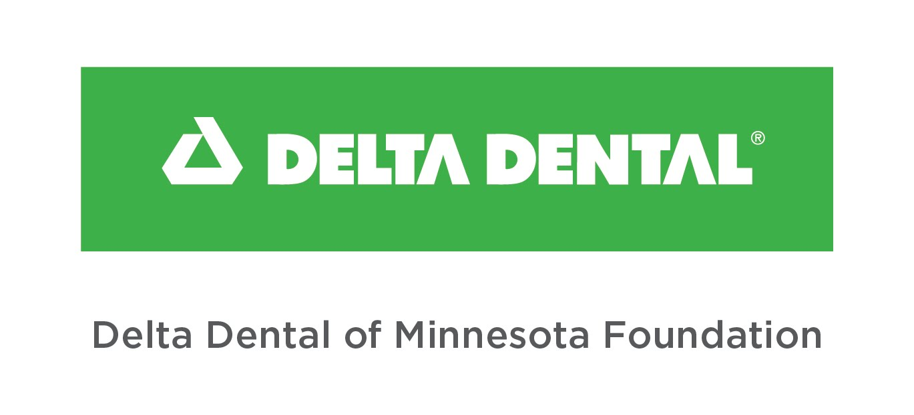

2003-2010
Normandale Community College Paved The Way
Survey of Minnesota licensed
dental hygienists
Collaborative practice forum
Follow-up Q and A sessions
Website developed and
maintained
Faculty fielding questions
regarding collaborative agreements
Notes:
When the law passed in 2001, Normandale Community College dental hygiene program “paved the way”.
The initiative was supported with grant funds from Delta Dental of Minnesota Foundation; Minnesota Department of Health; Minnesota Community Foundation
I can’t begin to tell you how much activity was generated starting in the early years.
Dental hygienists were excited about the possibility to serve the community. We thought we were off and running.
Enthusiasm started to wane when dental hygienists experienced roadblocks,
finding a dentist who was willing to sign on as a collaborative dentist
confusion around the terms “employed or retained by” i.e., resulting in an interpretation that a dental hygienist who did not have employee status needed to create a “non-profit” status to work outside a traditional dental office– many hoops to go through
Those Hurdles Still Exist– 21 Years Later

Slide 8
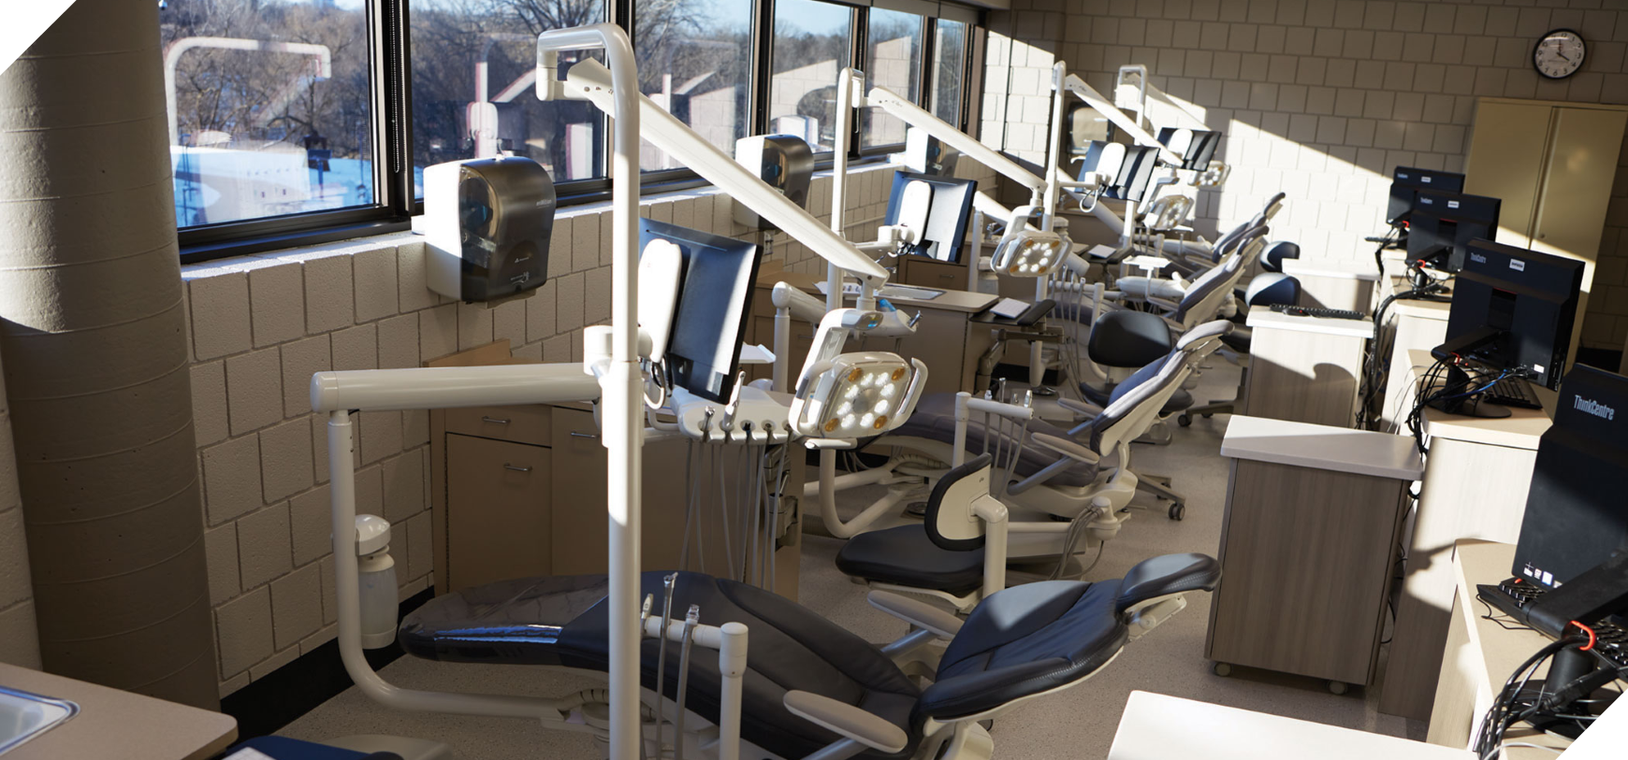
Notes:
So, let’s look at the “present” for a minute…..
This is where an oral healthcare professional’s education begins

Slide 9
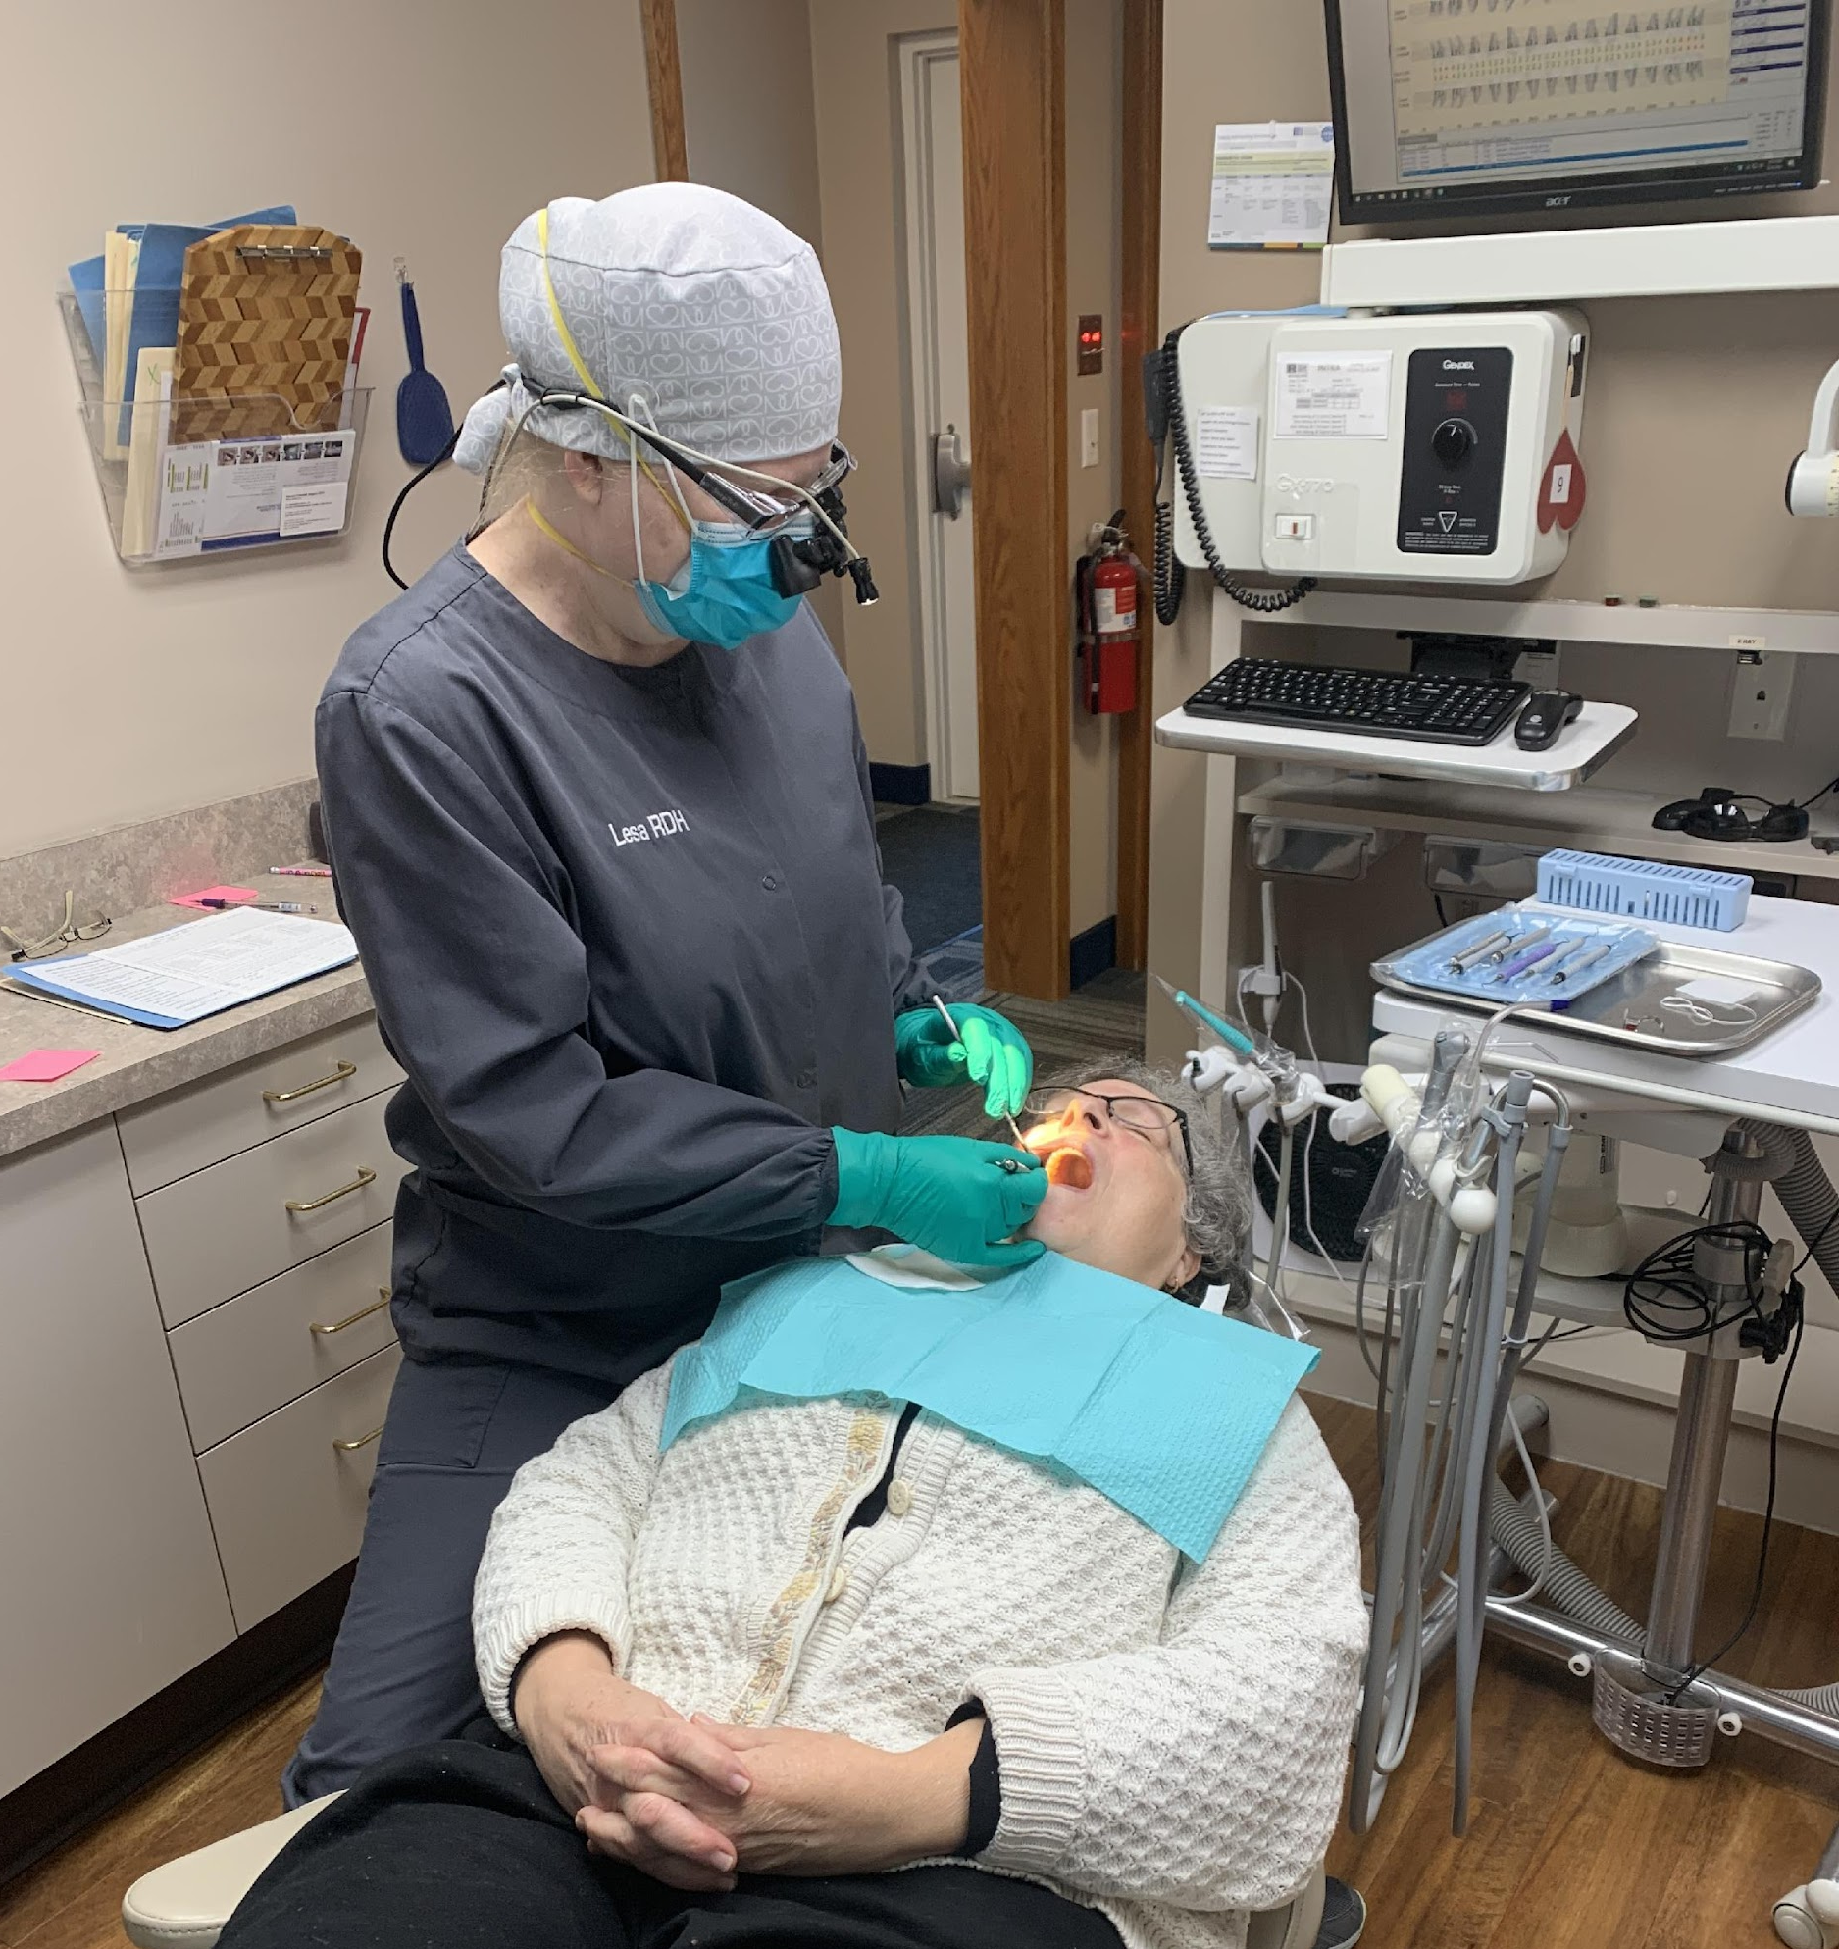
Traditional dental practice
Digital technology
Electronic record-keeping
Dentist in close proximity to your
operatory
Pleasant reception area
State of the art equipment,
instruments, supplies
More
Notes:
Upon graduation, the majority of graduates and currently licensed oral health professionals seek jobs in a traditional dental practice i.e. a “four walls, bricks and mortar dental office setting”.
Dental hygiene practice follows …..
Minnesota Statutes 150A.10 ALLIED DENTAL PERSONNEL.
Subdivision 1. Dental hygienists.

Slide 10
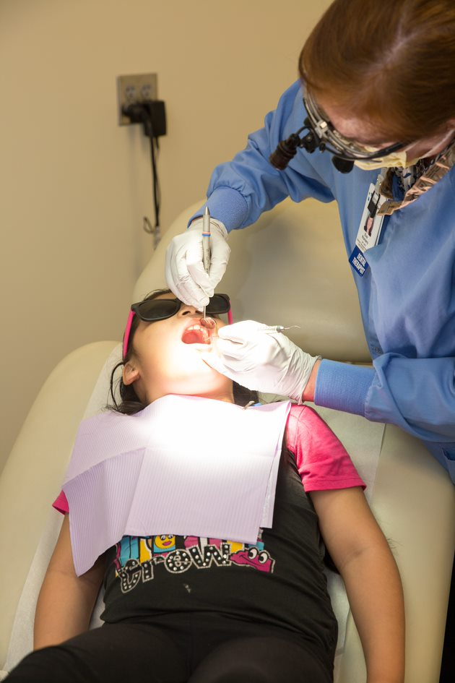

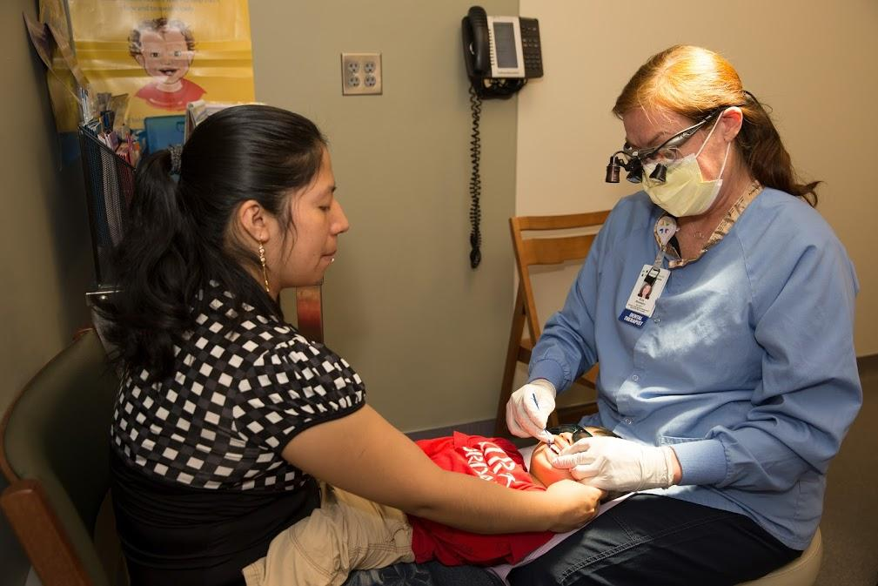
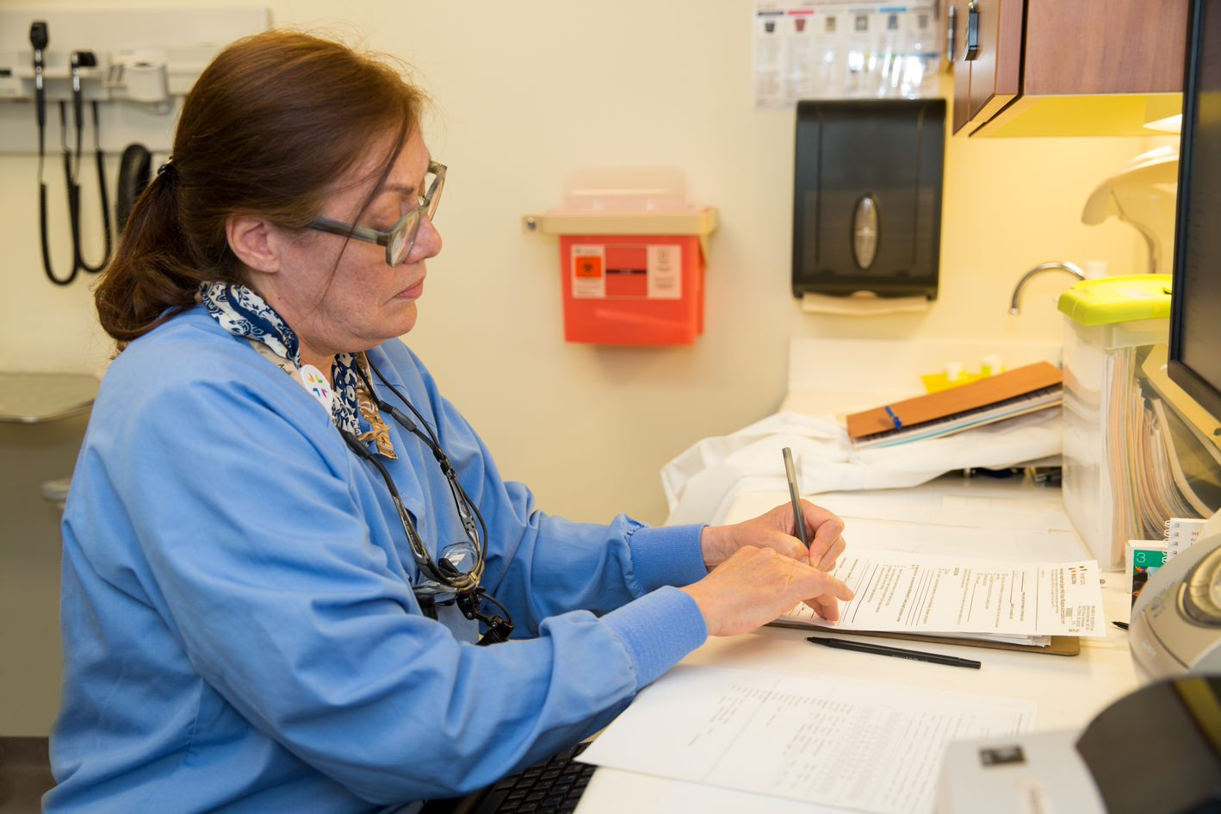
HRSA Grant Project Goals…
Strengthen the Collaborative Practice Infrastructure
Notes:
ADVOCATES FOR EQUITABLE ACCESS TO ORAL HEALTH CARE KEEP trying to make collaborative dental hygiene practice a wide-spread reality.
Normandale Community College under the direction of Dr. Colleen Brickle was awarded a significant, multi-year HRSA grant with one of the goals being to “strengthen the collaborative practice infrastructure”

Slide 11
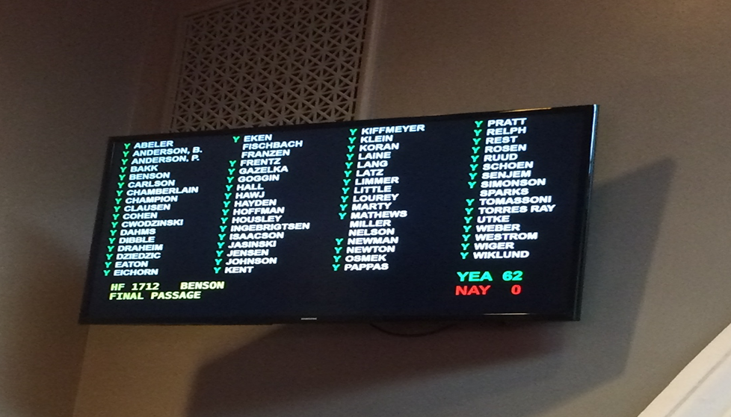
Policy Changes to Remove Barriers: Ongoing
Notes:
Change can make a difference
This is what it looks like at the Capitol when laws are updated/barriers are removed
Statutes (Minnesota Legislature)
Rules (Minnesota Board of Dentistry)

Slide 12
Minnesota Statutes. 150A.10, subd. 1a
Collaborative practice authorization for dental hygienists in community settings.
Dental hygienists may be…
Employed, e.g.
  Not-for-Profit: Apple Tree Dental, Community Dental Care, etc.
  Just Kids Dental, Let’s Smile, etc. (non-profit status was formed by individual dental hygienists)
Retained by, e.g.
  Unpaid/volunteer
Notes:
HOW DO I MAKE THIS WORK?
How does the financial side work?
How does the dental hygienist get paid?
No two models will be the same.
The business and financial aspects may be very different.
CDHP advocates put our creative minds together this legislative session
Brainstormed Ideas to support the “Dental Home Demonstration Project” mandate of the MN Department of Human Services
Innovative idea was introduced
* to authorize a dental hygienist who is employed in a private practice and that is not a Minnesota Health Care
Programs enrolled provider, to serve community sites and be directly reimbursed for their services, i.e. they become a
“pay-to-provider.”
That idea did not move forward in the legislature.

Slide 13
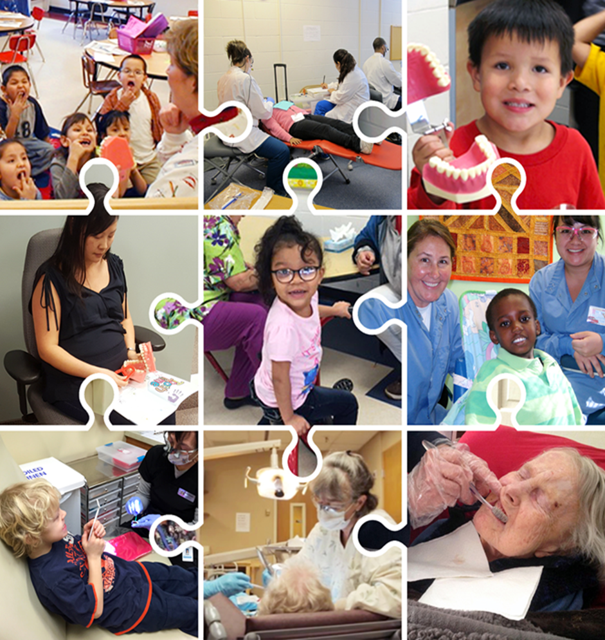
Populations Served by Collaborative Practice Dental Hygienists
Notes:
Populations to serve are many.
Starting on the upper left and moving clockwise…..

Slide 14



Community Settings
Health Care Facility, Program or
Non-profit Organization
Notes:
(d) For the purposes of this subdivision, a "health care facility, program, or nonprofit organization" includes a hospital; nursing home; home health agency; group home serving the elderly, disabled, or juveniles; state-operated facility licensed by the commissioner of human services or the commissioner of corrections; and federal, state, or local public health facility, community clinic, tribal clinic, school authority, Head Start program, or nonprofit organization that serves individuals who are uninsured or who are Minnesota health care public program recipients.

Slide 15
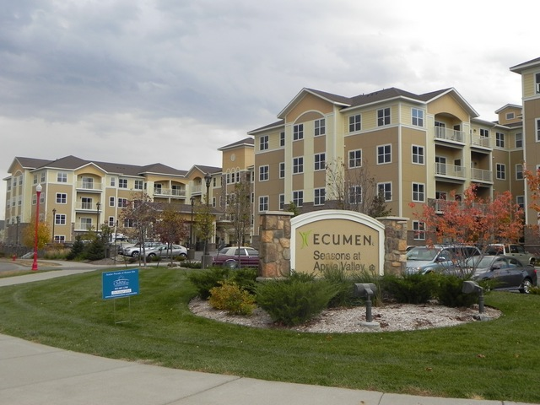
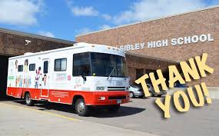
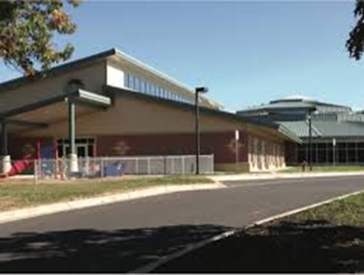
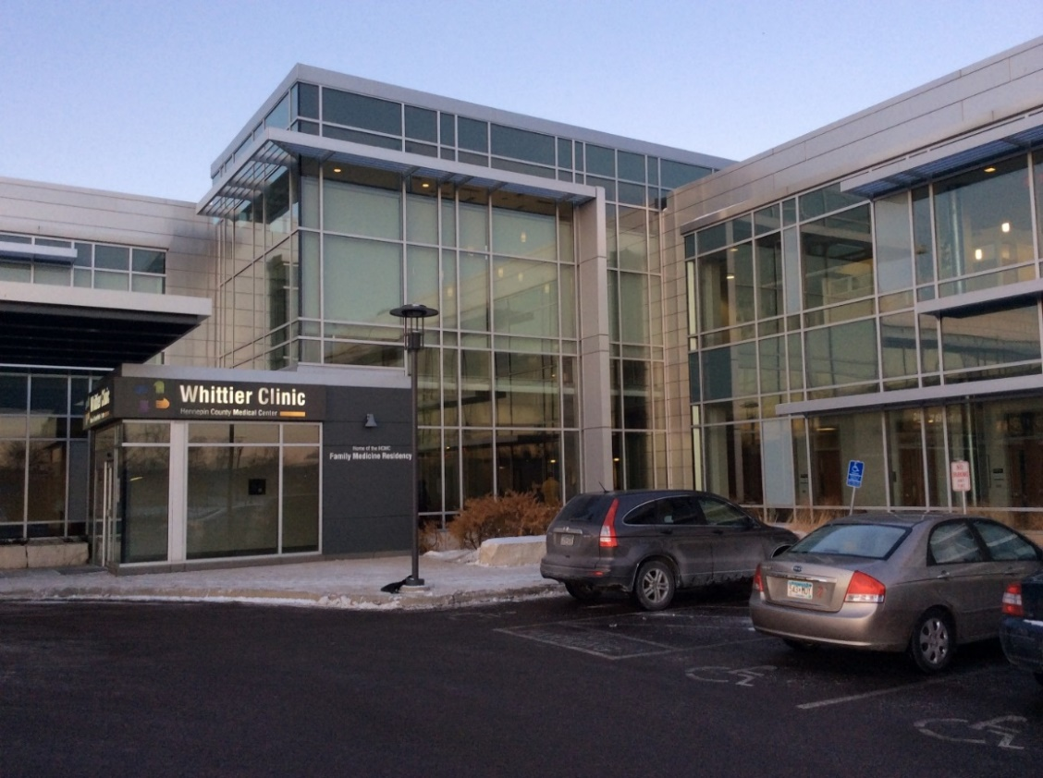
Community Settings

Slide 16
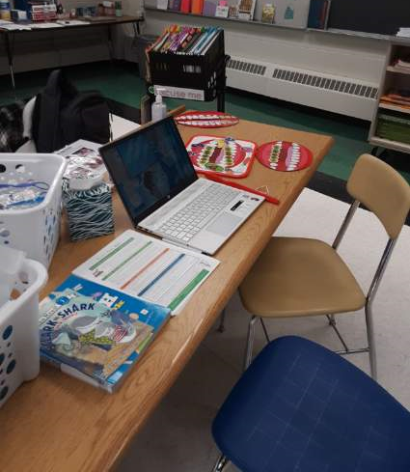

School-based programming: students need very little out-of-classroom time.
Notes:
https://icon-library.com/icon/icon-children-8.html
Photo Cannon Falls Elementary

Slide 17
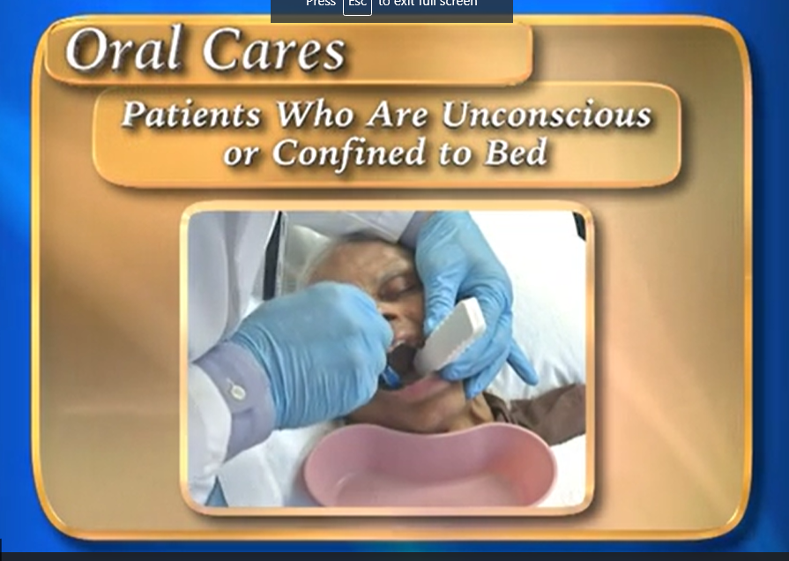
Notes:
https://www.mndental.org/public/oral-health/seniors-and-oral-health/
Serve home-bound patients– provide care in-place; transportation needs are reduced

Slide 18

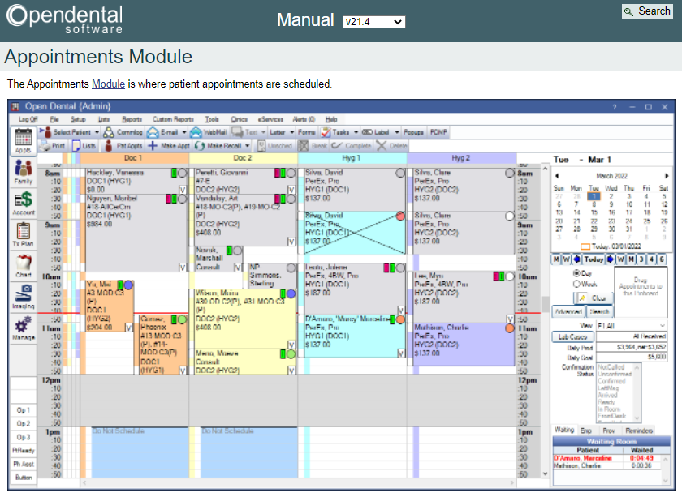
“Our schedule is
already FULL.”
“We don’t have openings in our schedule to treat Minnesota Health Care Program enrolled patients.”
Open Dental Software training example
https://www.opendental.com/manual/appointments.htm
l
Notes:
Discuss options…
Typical dental office schedule (hygiene columns show mostly 50-minute appointments; Doc 1 column shows a double-booking). Pre-appointment for dental hygiene re-care is common practice– assures a consistent patient flow/a means to meet business practice goals.
Offer variety to your dental hygienist employee in whom you have trust/confidence. e.g. if your office is closed on Fridays, the DH may want to work in a school-based program or local nursing home/assisted living site.
Ease the repetitive patient schedule
Note: this is an Open Dental Software website training example https://www.opendental.com/manual/appointments.html

Slide 19
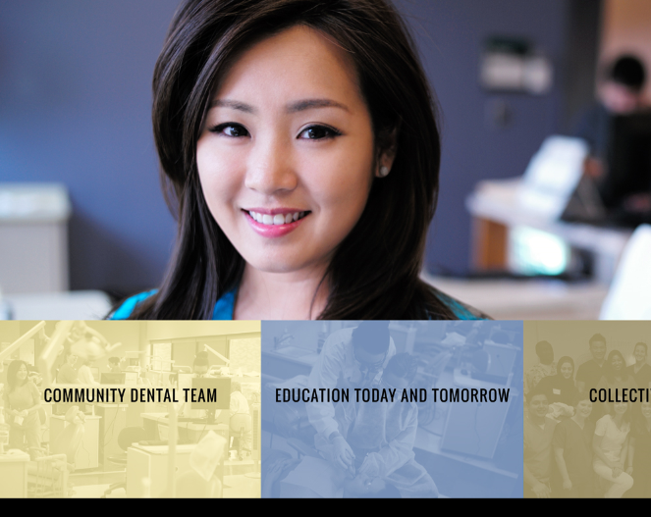
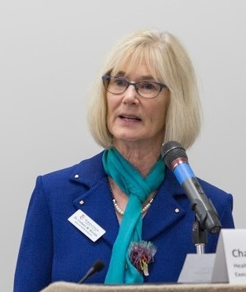
Minnesota’s 21st Century Dental Team Website
“Toolkit”
http://www.normandale.edu/mndentalteam
Notes:
“Minnesota 21st Century Dental Team”.
http://www.normandale.edu/mndentalteam

Slide 20
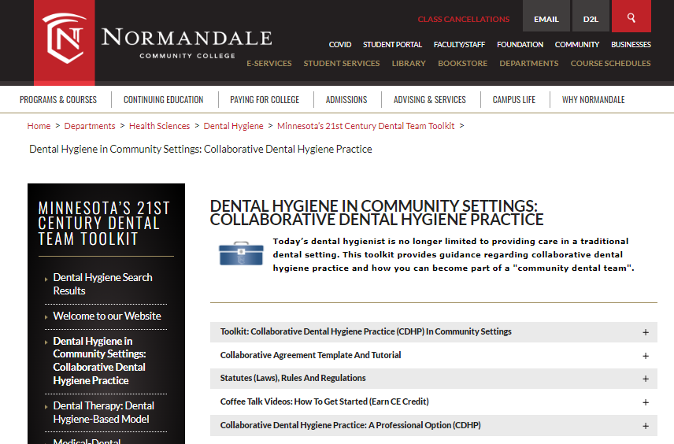

Slide 21
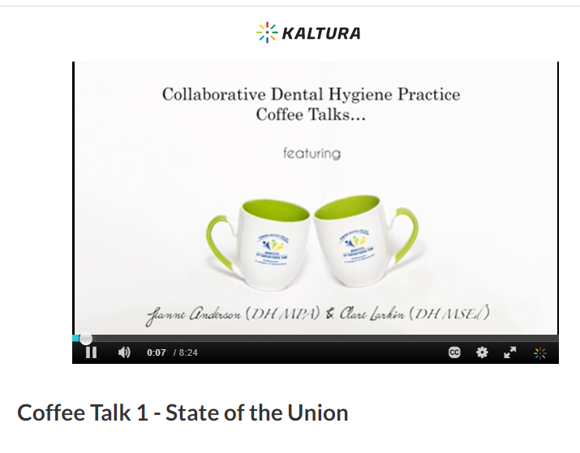
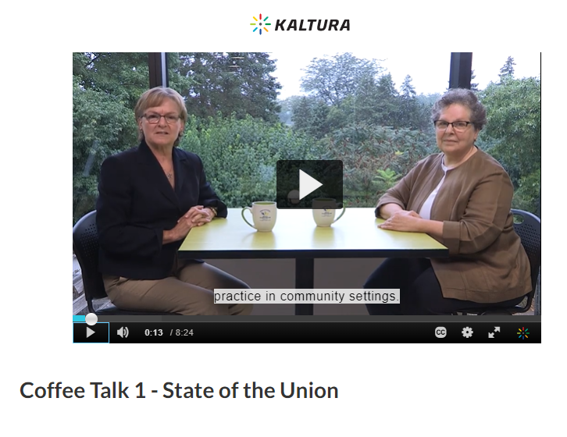

Slide 22
Collaborative Practice in
Action

Slide 23
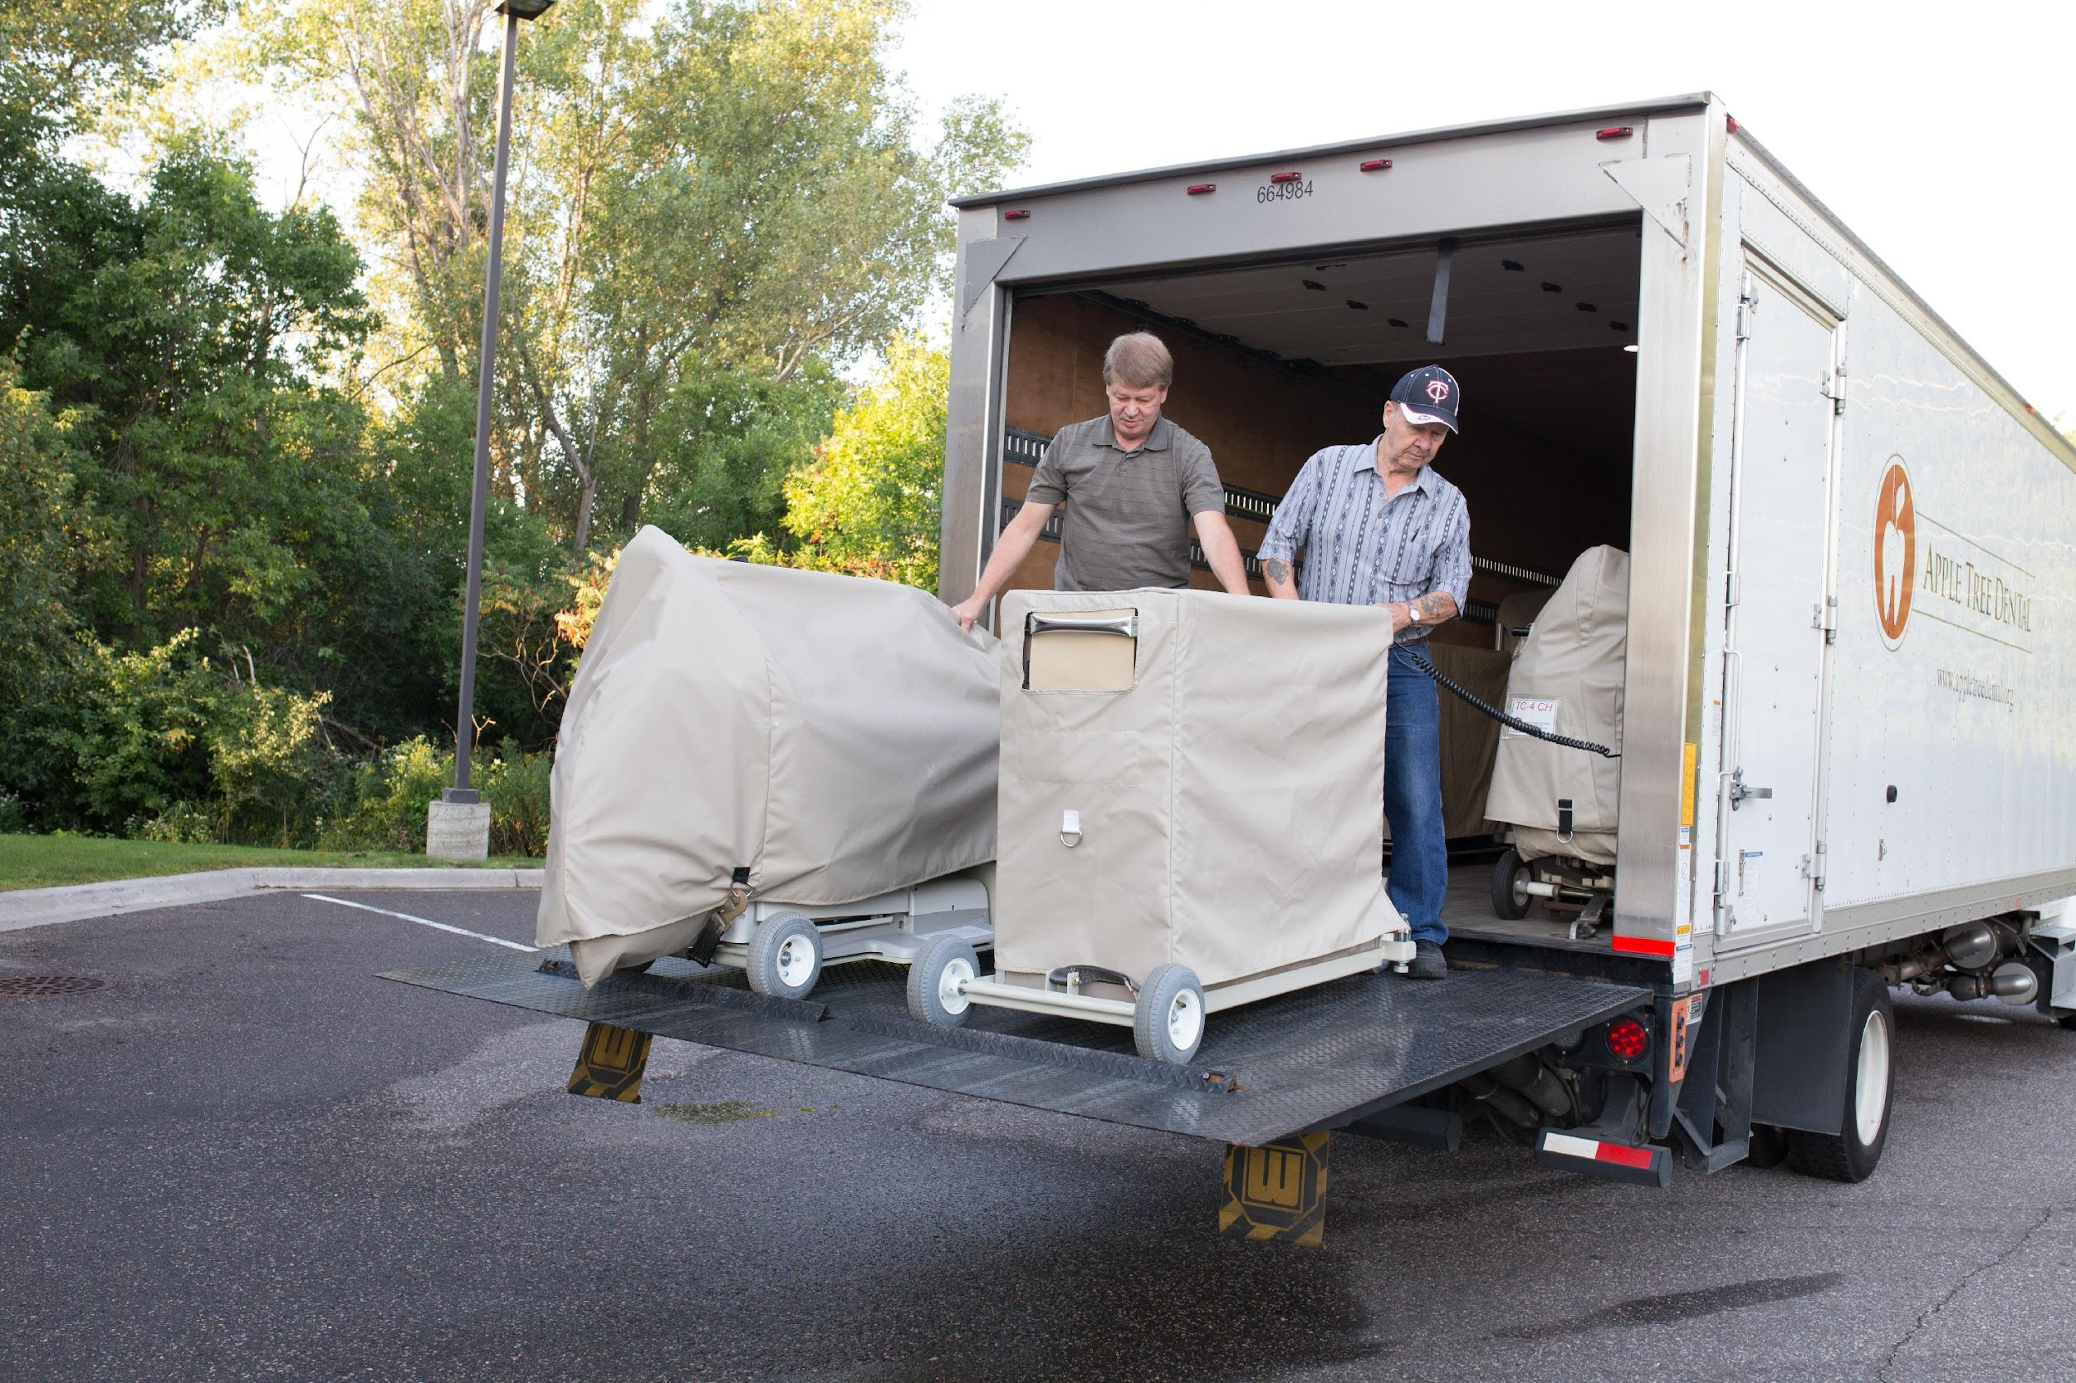
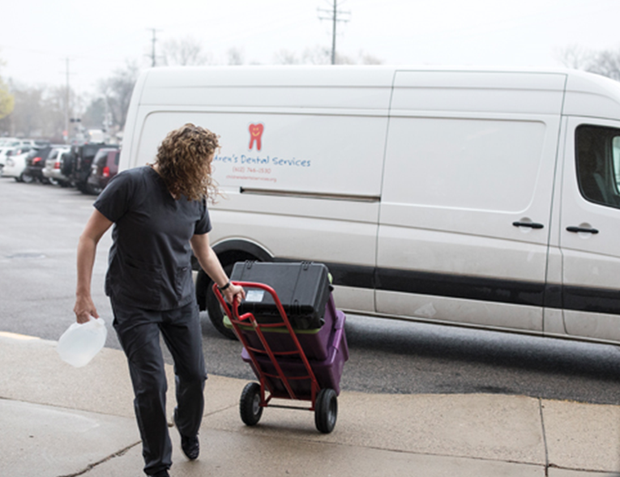
Portable Equipment: On the move

Slide 24
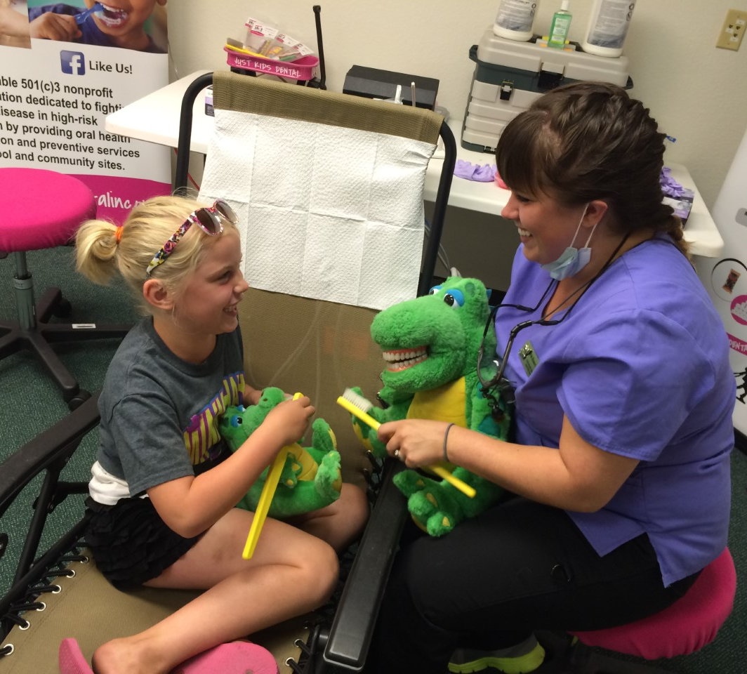
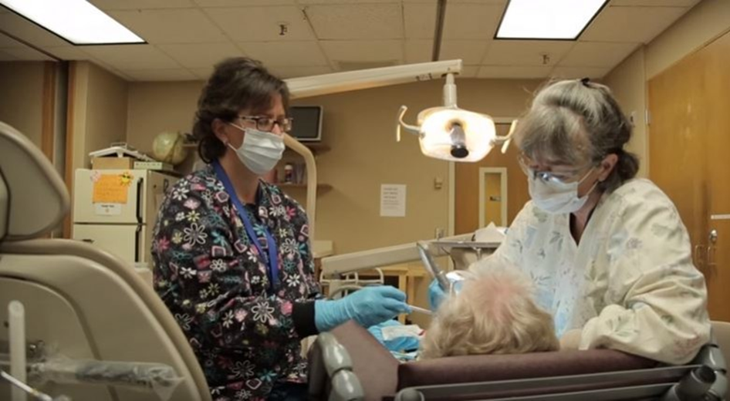

Slide 25
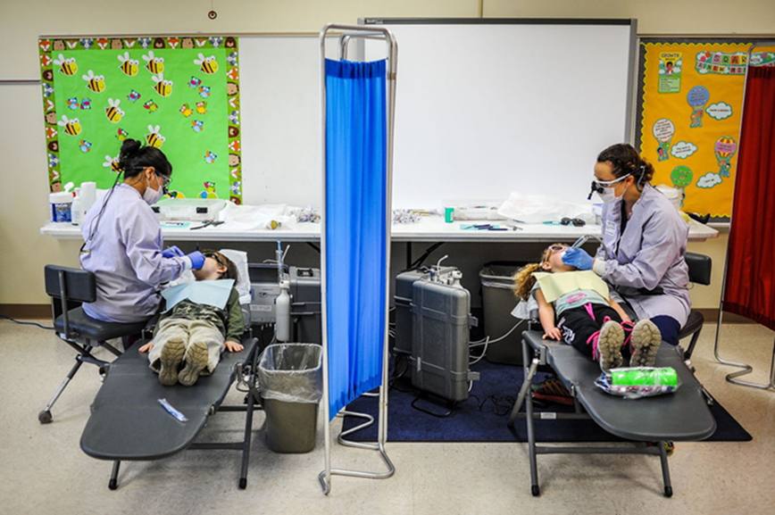
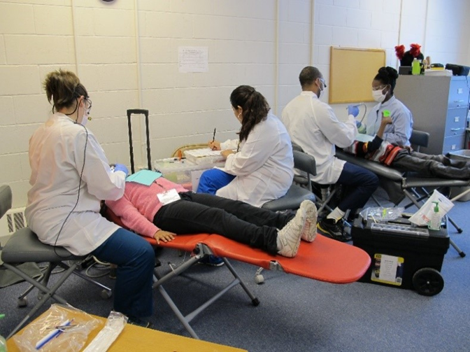
School-based Oral Health Programs

Slide 26
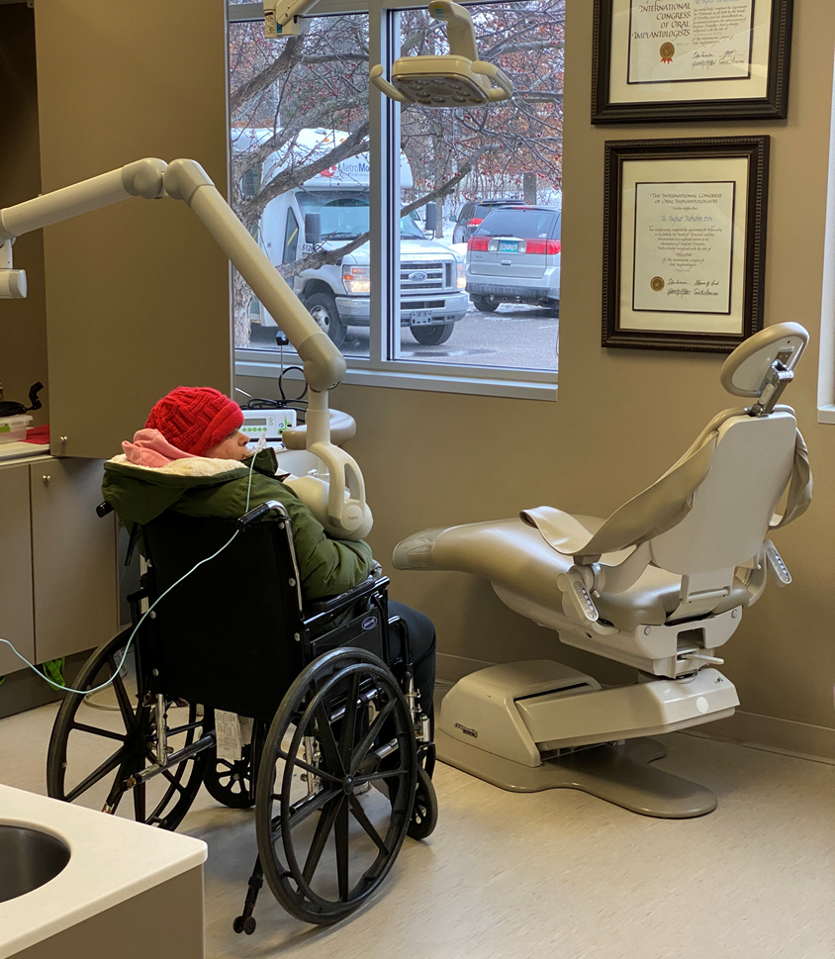
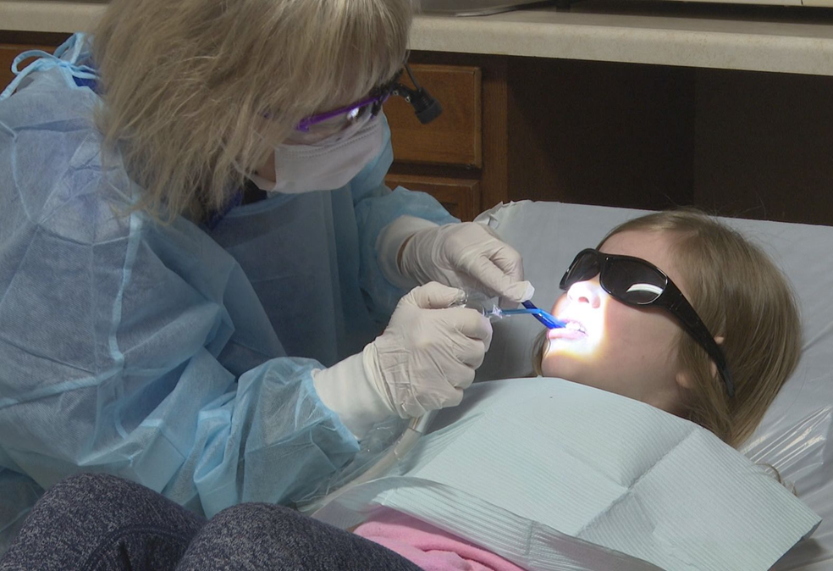

Slide 27
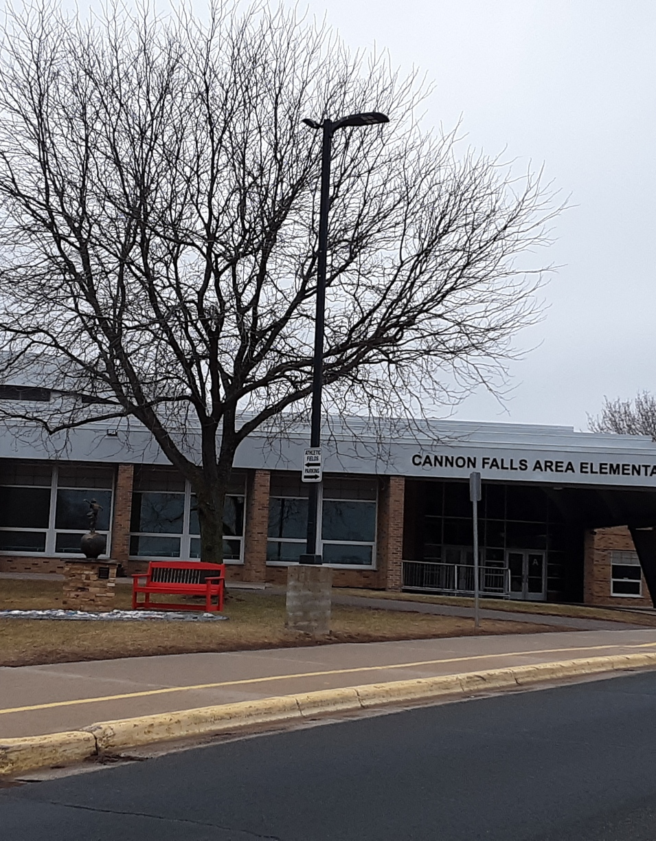
HOW CAN I MAKE THIS WORK?
Notes:
Normandale website/toolkit

Slide 28
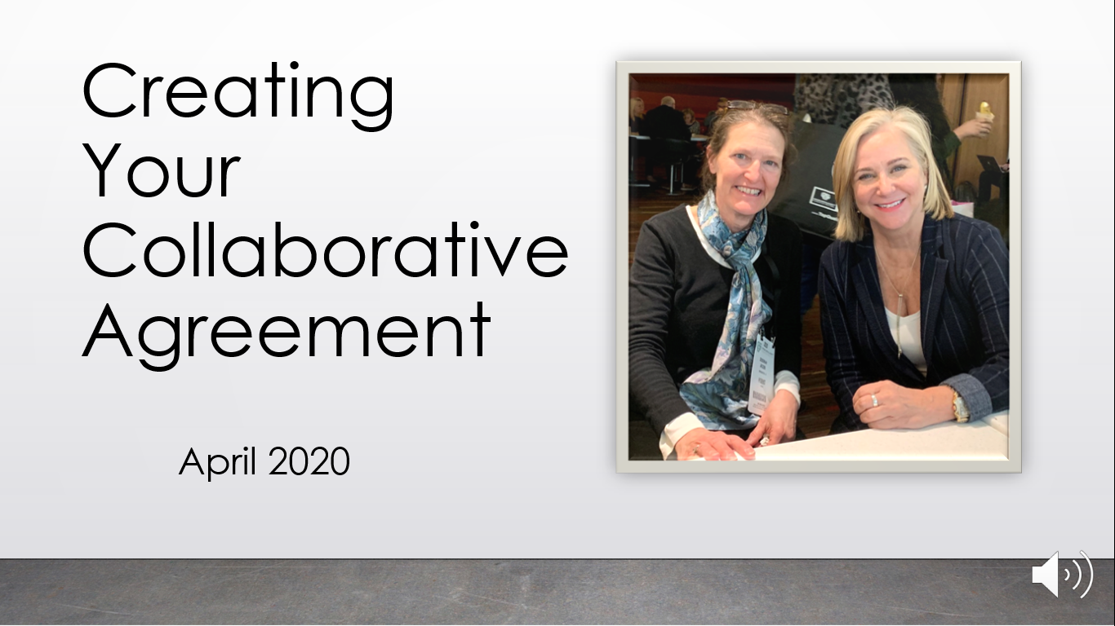
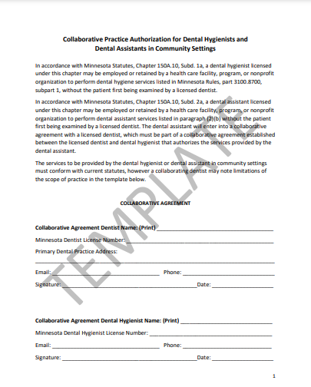
Notes:
Understand what is both required and recommended for community-based practice. Especially important to follow infection prevention and control practices.

Slide 29
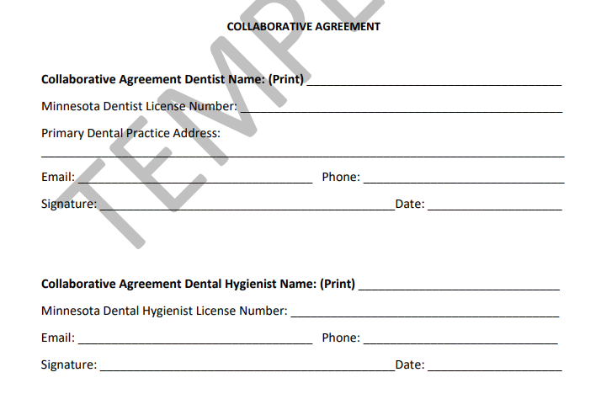
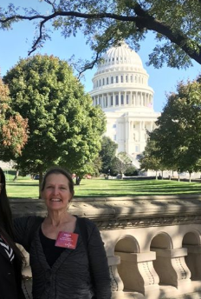

Slide 30
I want to help as many people as possible, but I don't necessarily want to work on a mobile dental clinic.
I want to maximize my impact on my community’s health while focusing on the procedures I went to school to learn.
Collaborative agreements allow a dentist to be as involved as they want to be in the community-based programs.
Agreements can be customized to fit
  both professionals’ work style
  the dental hygienist’s experience level early-on (start small; expand with comfort/experience).
Dental hygiene graduates have been educated in service-learning.
Can be used as a hiring incentive
  Offers variety in a dental hygienist’s day-to-day work routine; discourages burnout from a repetitious daily schedule.
Notes:
specifically recommend that students watch the Coffee Talks https://www.normandale.edu/communitydentalhygiene

Slide 31
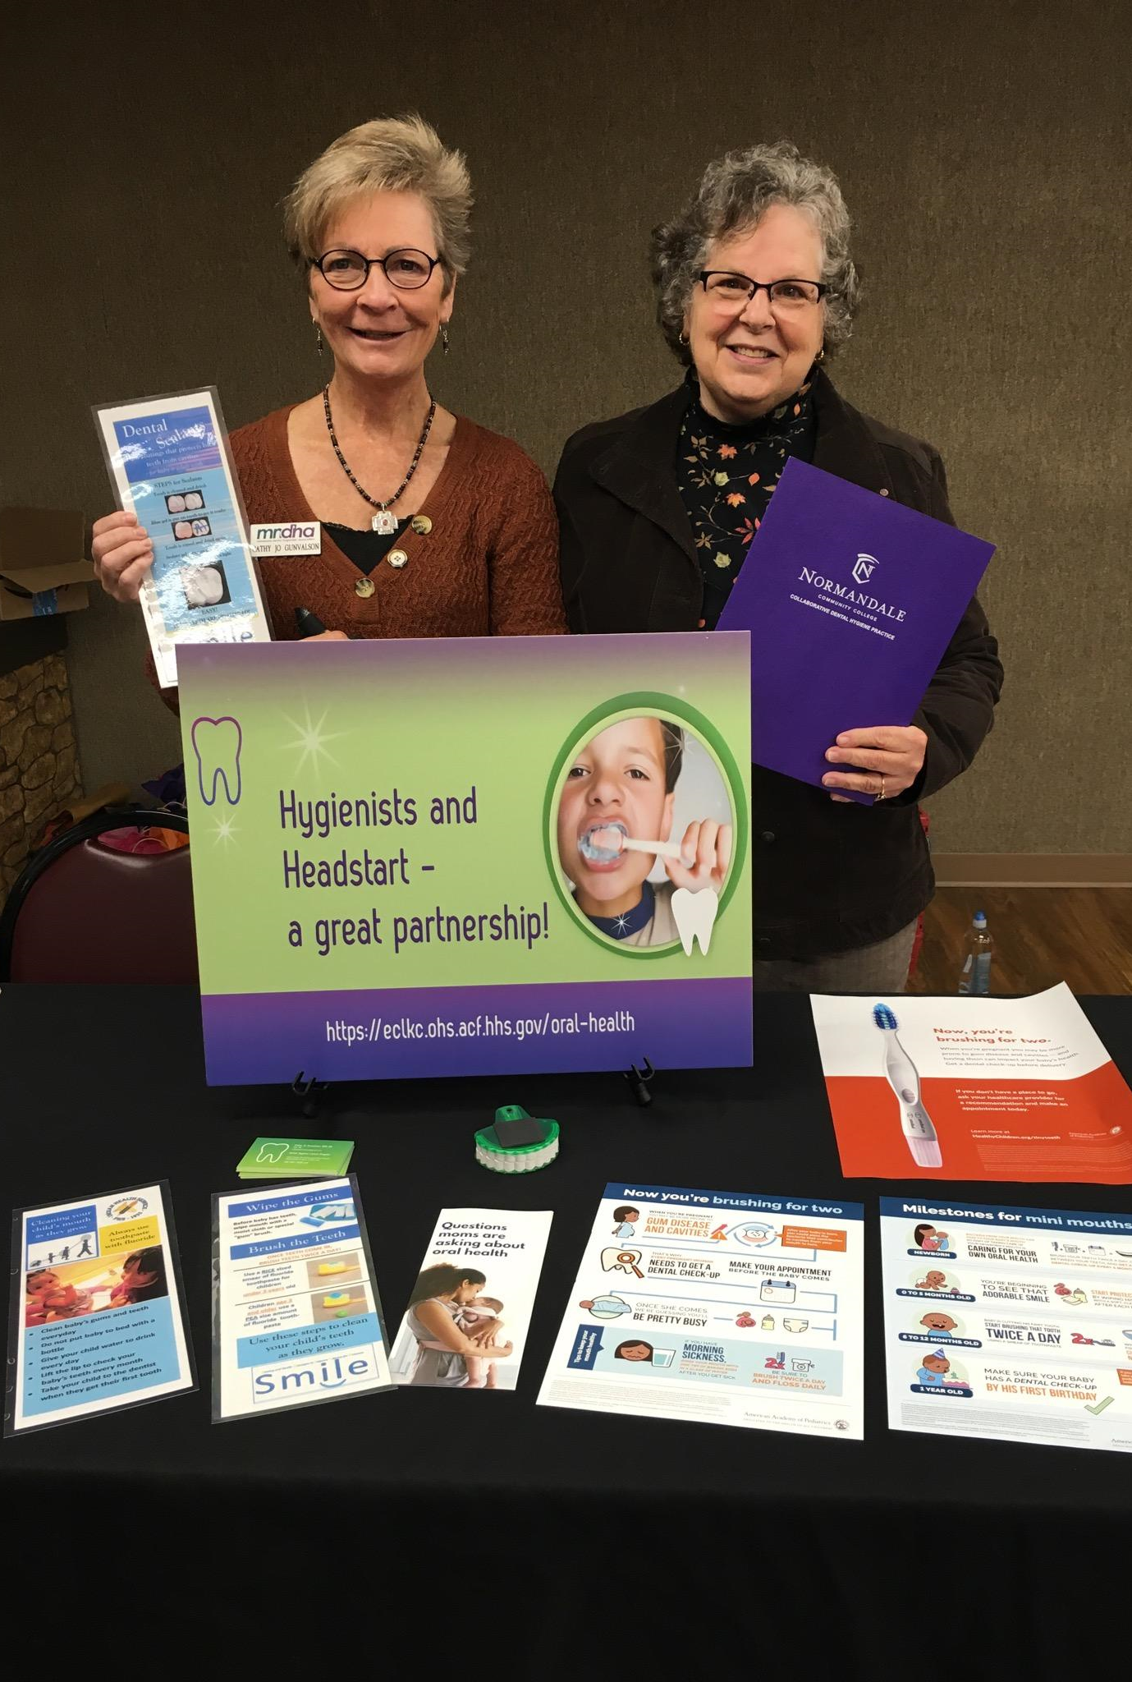
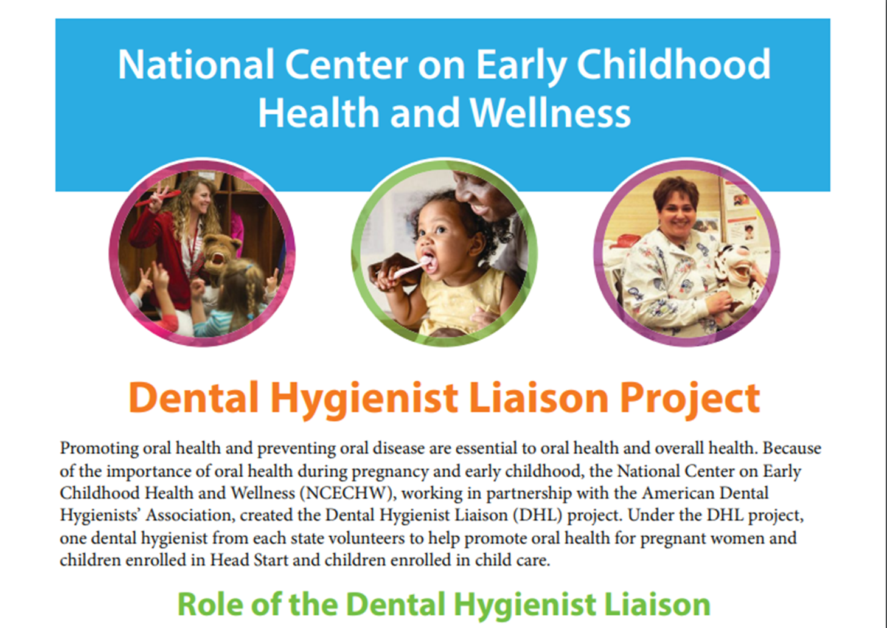
Notes:
Start small; contact Cathy Jo Gunvalson
National Center on Early Childhood Health and Wellness and ADHA

Slide 32
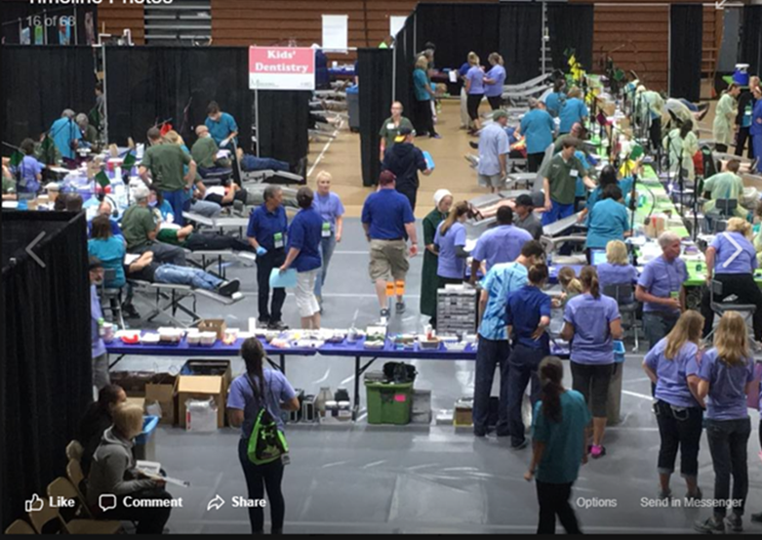
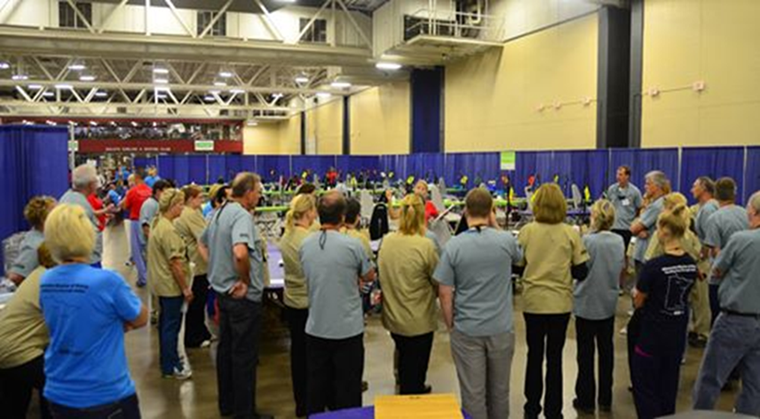
We can’t overlook the importance of volunteers in health care, however…
Notes:
Volunteerism isn’t a healthcare system. Saw on a bumper sticker years ago.
Volunteerism is not a health care “system.”
Everyone deserves to have a “dental home.”
A “dental home” does not need to be four walls/bricks and mortar building.
“Collaborative Dental Hygiene Practice in Community Settings” is a viable option to increase access to care.
QUESTIONS ?????
Whether you’re an experienced physician or new to the profession, caring for patients at volunteer clinics can revive your passion for practice and offer a mental break from some of the daily stressors that lead to physician burnout, according to members of the medical profession who regularly volunteer.
https://www.ama-assn.org/residents-students/resident-student-health/how-volunteering-has-made-doctors-students-happier-and
We Can’t Overlook the Importance of Volunteers in Health Care
https://healthcareinamerica.us/we-cant-overlook-the-importance-of-volunteers-in-health-care-d9231658b971

Slide 33
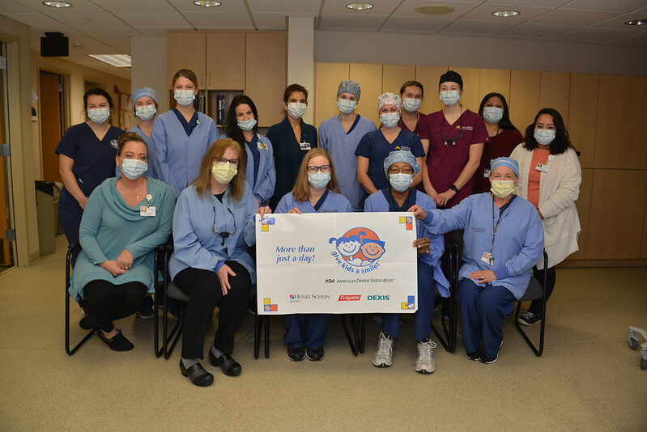
Notes:
Note the banner
Give Kids a Smile
“More than just a day!”
https://www.mndental.org/events/give-kids-a-smile/

Slide 34
Thank you
University of Minnesota
School of Dentistry
Lunch and Learn
April 2022
larkin3@Q.com
Notes:
Please feel free to contact me. Collectively I feel a lot can be accomplished.
CDHP is an innovative workforce model needed to prepare dental hygienists for the charge of
expanding the scope of practice with new competencies to meet the oral health care needs of vulnerable, underserved and rural populations.

