Slide 1

Is Dental Assisting
Right for You?

Slide 2
What is a
Dental
Assistant?
Visible members of a dental practice team.
It is an excellent career for someone that enjoys helping people.
Empathy, patience, and compassion are traits needed in the role, along with a strong knowledge of the field in support of the dentists and dental hygienists.

Slide 3
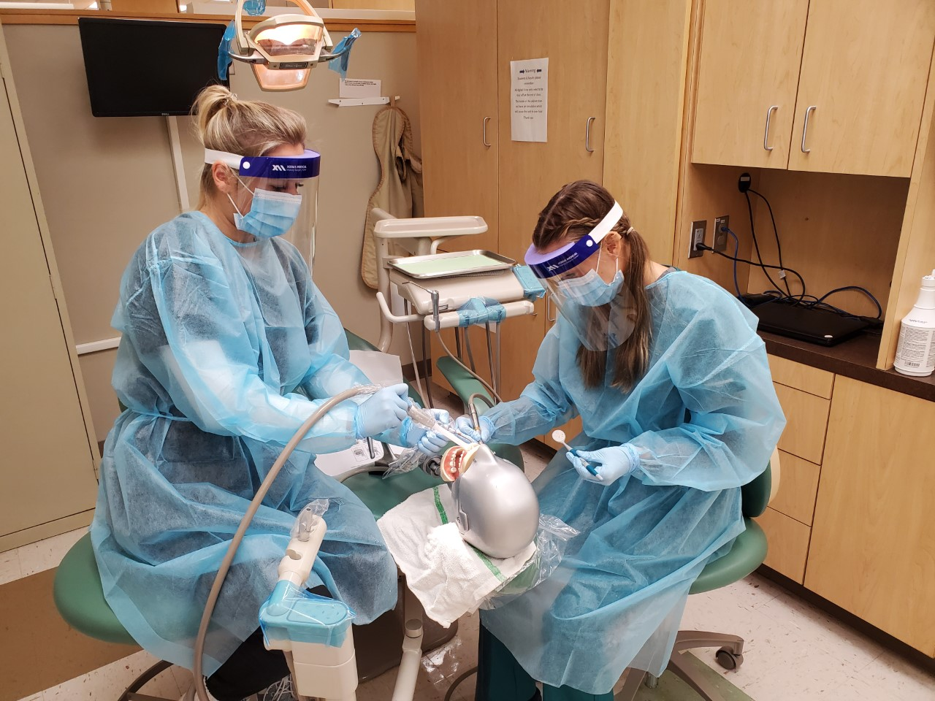

Slide 4
100%
Job Placement Rate
There is currently a shortage of dental assistants in every region of Minnesota.

Slide 5
FAST TRACK
to Employment
Certification and licensure can be obtained in as few as 11 months. Many dental assistants are employed within one year of entering a program.

Slide 6
Minnesota Ranks #1
for Dental Assistant Salaries in the Country
$25.33 an hour
Average salary in Minnesota
$26.62 an hour
Average salary in 7 county metro area

Slide 7
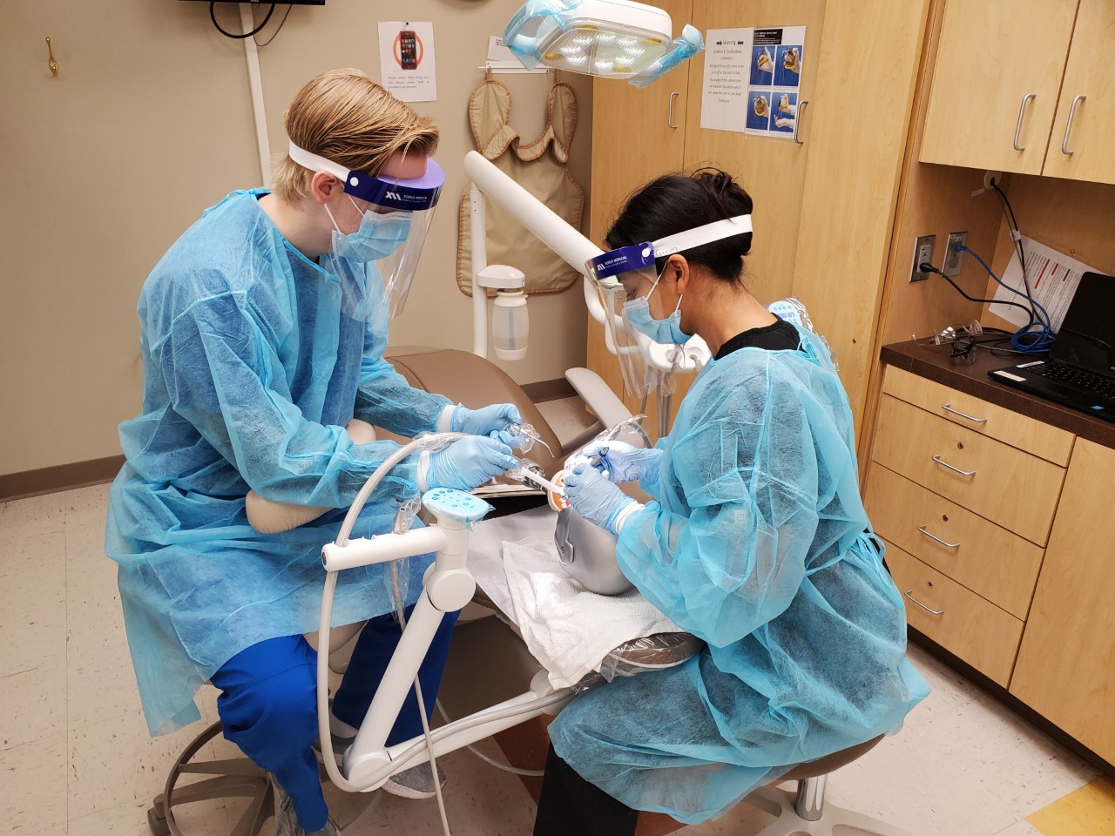

Slide 8
Dental Assistants Have a Very Important Role
They teach patients proper preventative care
They assist dentists with procedures during routine cleanings, dental procedures, or trauma
Dental assistants also ensure health and safety protocols are followed at all times

Slide 9
Assisting
assisting the dentist during a variety of treatment procedures
Taking and developing
taking and developing dental radiographs (x-rays)
Verifying
verifying about the patient's medical history and taking blood pressure
and pulse
Serving
serving as an infection control officer, developing infection control protocol and preparing and sterilizing instruments and equipment
Helping
helping patients feel comfortable before, during and after dental treatment
Providing
providing patients with instructions for oral care following surgery or other dental treatment procedures, such as the placement of a restoration (filling)
What Does a Dental Assistant Do?

Slide 10
Teaching
teaching patients appropriate oral hygiene strategies to maintain oral health; (e.g., tooth brushing, flossing and rinsing)
Taking
taking impressions of patients' teeth for study casts (models of teeth)
Performing
performing office management tasks that often require the use of a personal computer
Connect
communicating with patients and suppliers (e.g., scheduling appointments, answering the telephone, billing and ordering supplies)
Helping
helping to provide direct patient care in all dental specialties, including orthodontics, pediatric dentistry, periodontics and oral surgery
What Does a Dental Assistant Do?

Slide 11
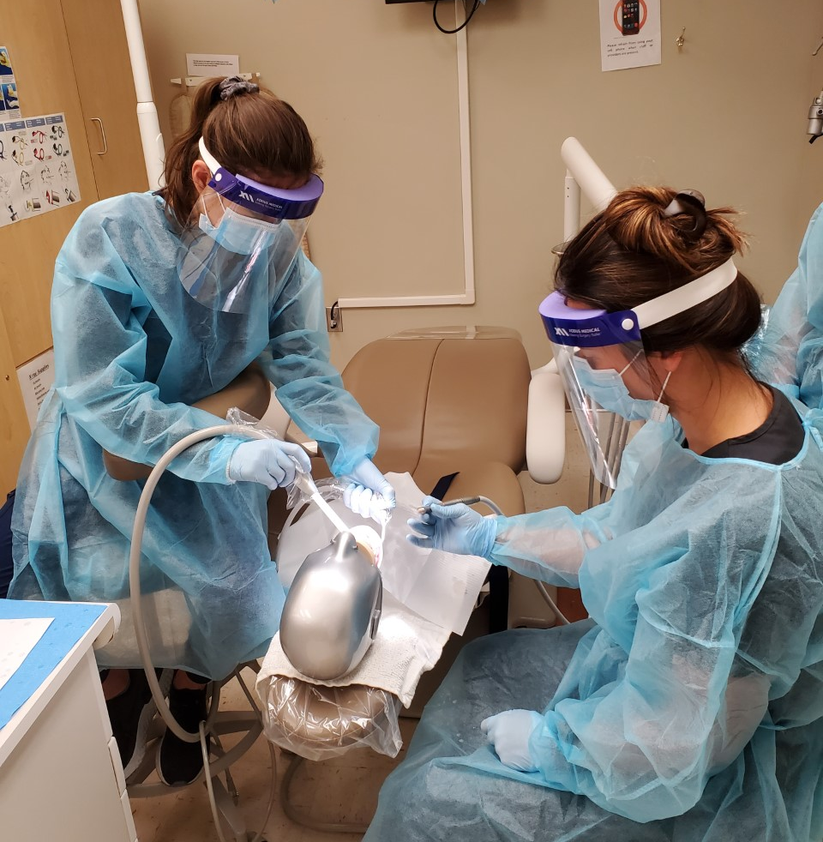
Dental Assisting
Great pay and job security
Mentorship and
supportive workplace
Advancement and
career growth
You make a difference
Variety of duties
What Does a Dental Assistant Do?

Slide 12


Become a Vital Member of a Health Care Team
Dental Assistants Have a Very Important Role

Slide 13

Skills Needed
to be a Dental Assistant
If you’ve decided to pursue a career in dentistry, you may be wondering, “what does it take to be a dental assistant?” Because the duties are so broad, there are a variety of skills you will receive in your training.

Slide 14
Outlook for Dental Assistants
in Minnesota
Pays above the statewide median wage
The State of Minnesota reports that dental assisting is a high demand field
Dental assisting is seeing high growth compared to other careers

Slide 15
Expanded Functions
Dental assisting is a great career and now there are more opportunities than ever before.
This Minnesota Board of Dentistry authorizes dental assistants to be educated in expanded functions such as taking dental x-rays, polishing teeth, placing dental sealants, fabricating temporary crowns, administering nitrous oxide sedation and orthodontic duties.
The Minnesota Dental Practice Act allows a licensed dental assistant or dental hygienist to perform certain restorative procedures under indirect supervision upon completion of a board-approved course and issuance of a Restorative Functions (RF) credential.
See the Minnesota Board of Dentistry website for more information on expanded functions.

Slide 16

Interested?
More information is available at:
www.minnesotaoralhealthcoalition.org

